Slide 1
Unite States Mineral Imports
Assignment 7
Alex Khaykin

Slide 2
Introduction
Imports of natural and rare earth minerals from around the world including countries viewed as allies / none-allies and their impacts on major U.S. industries

Slide 3
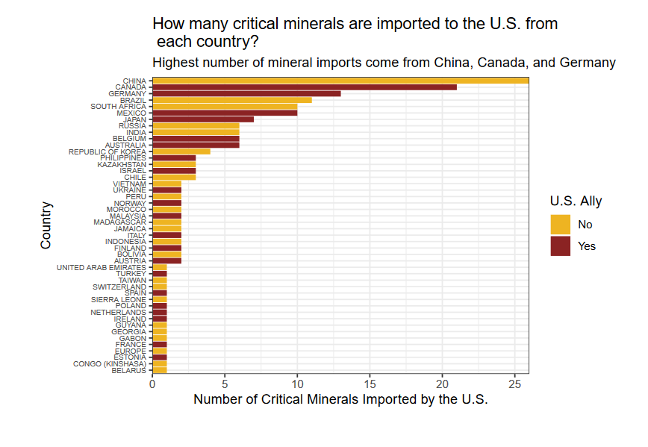

Slide 4
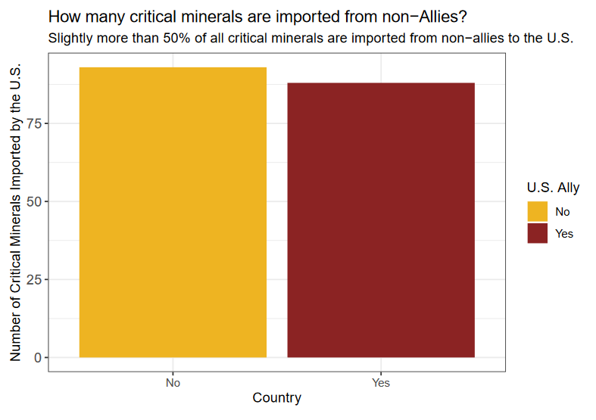

Slide 5
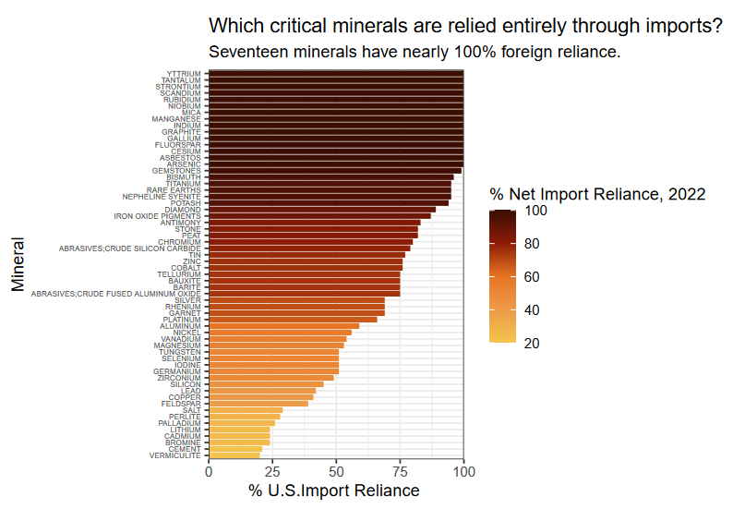

Slide 6
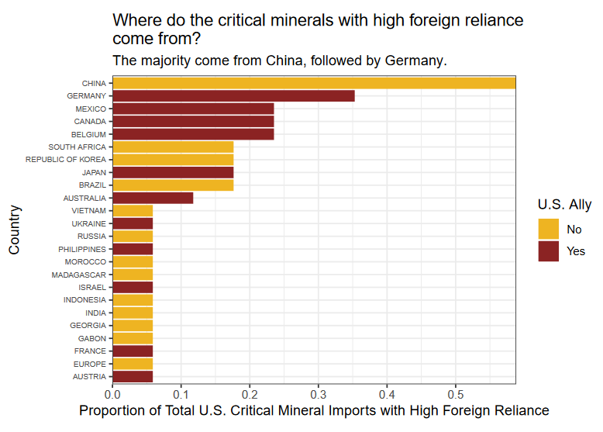

Slide 7
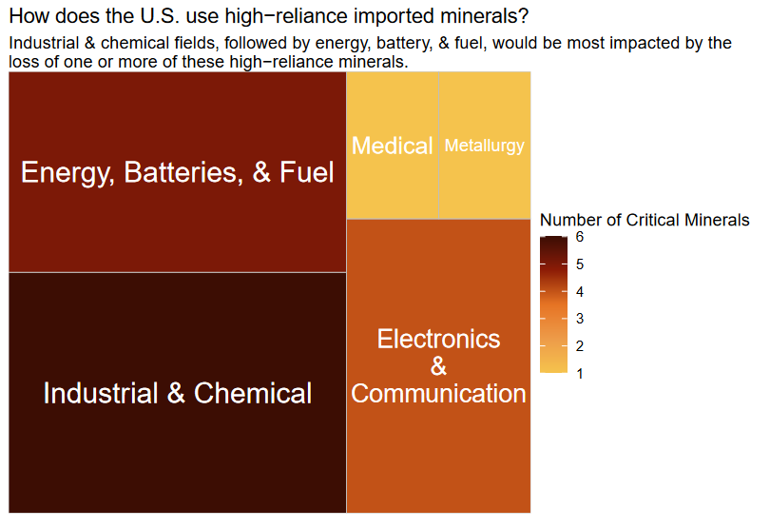

Slide 8
Conclusion
United States is increasingly reliant on trade in rare earth minerals with countries who’s political and geo-political interests run counter to those of U.S. If trade were to be impacted for any number of reasons in such minerals, critical industries such as Energy, Communications, and Medical sectors would be just some of the most impacted.

Slide 9
Sources
https://www.sciencebase.gov/catalog/item/63b5f411d34e92aad3caa57f
https://www.pewresearch.org/global/2019/12/05/

